Slide 1

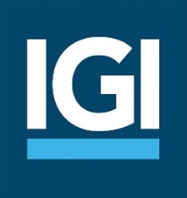
IGI Investor Presentation
Third Quarter 2023
November 2023

Slide 2
Forward Looking Statements
This presentation contains “forward-looking statements” within the meaning of the “safe harbour” provisions of the Private Securities Litigation Reform Act of 1995. The expectations, estimates, and projections of the business of IGI may differ from its actual results and, consequently, you should not rely on forward-looking statements as predictions of future events. Words such as “expect,” “estimate,” “project,” “budget,” “forecast,” “anticipate,” “intend,” “plan,” “may,” “will,” “could,” “should,” “believes,” “predicts,” “potential,” “continue,” and similar expressions are intended to identify such forward-looking statements. Forward-looking statements contained in this presentation may include, but are not limited to, our expectations regarding the performance of our business, our financial results, our liquidity and capital resources, the outcome of our strategic initiatives, our expectations regarding pricing and other market conditions, and our growth prospects. These forward-looking statements involve significant risks and uncertainties that could cause the actual results to differ materially from the expected results. Most of these factors are outside of the control of IGI and are difficult to predict. Factors that may cause such differences include, but are not limited to: (1) changes in demand for IGI’s services together with the possibility that IGI may be adversely affected by other economic, business, and/or competitive factors globally and in the regions in which it operates; (2) competition, the ability of IGI to grow and manage growth profitably and IGI’s ability to retain its key employees; (3) changes in applicable laws or regulations; (4) the outcome of any legal proceedings that may be instituted against the Company; (5) the potential effects of the COVID-19 pandemic and emerging variants; (6) the effects of the hostilities between Russia and Ukraine and the sanctions imposed on Russia by the United States, European Union, United Kingdom and others; (7) the effects of the war between Israel and Hamas; (8) the inability to maintain the listing of the Company’s common shares or warrants on Nasdaq; (9) the failure to realize the anticipated benefits of the acquisition of EIO; and (10) other risks and uncertainties indicated in IGI’s filings with the SEC. The foregoing list of factors is not exclusive. In addition, forward-looking statements are inherently based on various estimates and assumptions that are subject to the judgment of those preparing them and are also subject to significant economic, competitive, industry and other uncertainties and contingencies, all of which are difficult or impossible to predict and many of which are beyond the control of IGI. There can be no assurance that IGI’s financial condition or results of operations will be consistent with those set forth in such forward-looking statements. You should not place undue reliance upon any forward-looking statements, which speak only as of the date made. IGI does not undertake or accept any obligation or undertaking to release publicly any updates or revisions to any forward-looking statements to reflect any change in its expectations or any change in events, conditions, or circumstances on which any such statement is based.

Slide 3

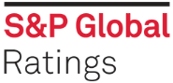
Overview
IGI is an international specialist (re)insurance group with deep technical expertise providing coverage across a diversified portfolio of specialty lines
“Underwriting first” individual risk underwriting strategy focused on profitable growth, diversification, and lower volatility
Underwriting portfolio well-diversified by line of business, product, and territory serviced by 116 underwriters⁽¹⁾ across 8 offices
Performance-based culture with well-respected and recognized leadership and proven expertise in intelligent risk selection across a diverse range of specialty lines
Uniquely positioned to capitalize on market opportunities through dynamic portfolio management across market cycles
Balance sheet strength and stability focused on capital preservation underpinned by a prudent reserving philosophy and conservative investment strategy
Strong shareholder alignment through significant insider ownership (Jabsheh family ownership: 33.1%)
Key Market Data⁽¹⁾
Stock Exchange Nasdaq
Symbol IGIC
Market Cap/Price $524mm / $11.28
Sh. Equity/BVPS $470mm / $11.04
Employees 398
A
A-
Commitment to long-term total value creation through growth in tangible book value per share plus dividends
(1) Data as of September 30, 2023

Slide 4
Track Record of Maximizing Total Value Creation
Tangible Book Value Per Share plus Dividends
CAGR 2013 – 9/30/2023: 5.5%
Public listing on Nasdaq⁽¹⁾
(1) IGI completed a business combination with Tiberius Acquisition Corp. and began trading on Nasdaq on March 18, 2020. As a result of the Business Combination, $41 million of capital was raised; in addition, IGI’s total shares outstanding were reduced causing a dilutive impact of approximately 33%.
Core Operating Return on Average Shareholders’ Equity
Average ROE 2013-9/30/2023: 13.1%
Annualized

Slide 5
Superior Total Value Creation
Proven track record of higher, more consistent returns with lower volatility
Return on Tangible Equity and Sharpe Ratio
12/31/2013-12/31/2022
Higher Volatility, Higher Returns
Lower Volatility, Higher Returns
Higher Volatility, Lower Returns
Lower Volatility, Lower Returns
Source: Dowling Research. Note: The chart represents 10-year average ROTE and Sharpe ratio (or shorter period for companies where 10 years is not available). Sharpe ratio is estimated as the difference
between 10 Year average ROTE and 10 Year Mean U.S. Treasury, divided by the Company’s ROTE Standard Deviation.

Slide 6
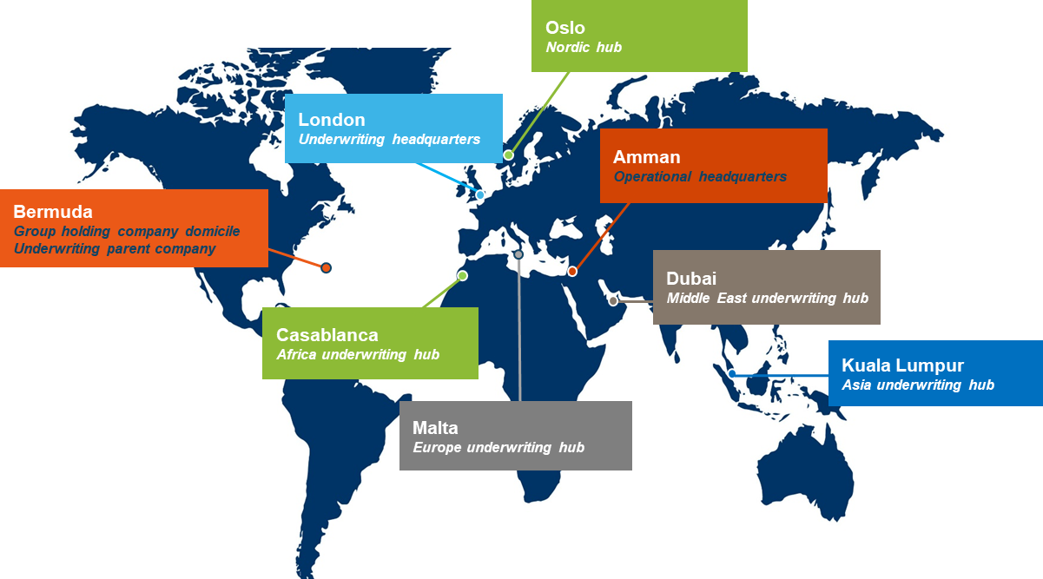
Global Presence, Local Knowledge
Main underwriting hubs in UK, Europe, Middle East / North Africa, Asia Pacific covering a mix of mature and high-growth, under-represented geographies
Distribution relationships and presence in key territories with high degree of local knowledge, cultural compatibility, and trusted relationships

Slide 7
Strategy to Maximize Total Value Creation over the Long-term
Consistent Execution of Underwriting Strategy
Balance Sheet Strength, Prudent Use of
Capital
Track Record of Strong Underwriting Results
Individual risk underwriting facilitates tighter risk control
Underwriting strategy results in average ~4 pt combined ratio advantage¹ vs. peers
Maintain optimal level of capital for “underwriting first” strategy; return excess capital in dividends, share repurchases
Global footprint, local knowledge, long relationships
10-year average² 87.5% combined ratio
Deep technical expertise, specialized experience
Zero financial leverage
10-year² average 13.1% core operating ROE, including soft market years
Dynamic cycle management, focused on lines with strong margins and rate momentum
Prudent reserving philosophy
Conservative investment portfolio structure – high quality fixed income; duration management
Superior risk adjusted return, low relative volatility³
Lower volatility, prudent use of reinsurance, managed catastrophe exposure
(1) Represents difference in average combined ratios for the period 2013–9/30/2023 between IGIC and peers. Peers include: MKL, ACGL, WRB, RE, RNR, HSX-LON, AXS, RLI, BEZ-LON, ARGO, KNSL, LRE-LON, JRVR and Lloyd’s of London
(2) 2013-Q3 2023 (annualized)
(3) Source Dowling Research (see Slide 5)

Slide 8
Well-Positioned for Future Total Value Creation Opportunities
Build-out of US/European Business
US: $72.8mm through September 2023, including E&S business; all short-tail, primarily energy, property, and contingency
Europe: $53.3mm through September 2023; predominantly long-tail lines, supplemented by some short-tail business
Steady growth in short-tail and reinsurance lines where conditions remain strong: cumulative net rate increases at 9/30/2023: 9.1% short-tail; 26.6% treaty reinsurance
Continued build out of long-tail opportunities in Europe and Nordic region, MENA region, and Asia Pacific, with dedicated expertise expanded in these regions
Demonstrated ability to shift underwriting focus with market opportunities
Capitalize on Market Opportunities
Continued Focus on Diversification and Growth
Expected growth in Nordic markets through acquisition of Norwegian energy MGA
On-the-ground presence in Bermuda with gradual buildout of reinsurance treaty business
Single “hub” underwriting approach promotes efficiency in decision-making across markets
Continuous evaluation of opportunities to enter new lines/markets while maintaining overall risk appetite
Efficient use of capital, prioritizing profitable growth in underwriting first, then returning capital to shareholders through dividends and share repurchases; repurchases 2022/2023 (through September 30, 2023) = 3,329,800 common shares; utilized 67% of current authorization
Current share repurchase authorization of up to 5 million common shares; regular quarterly common share dividend of $0.01 per share
Announced the purchase of all outstanding warrants (17.25 million) at a price of $0.95 per warrant in cash; final settlement and delisting of warrants from Nasdaq in Q4 2023
Prudent Capital Management

Slide 9
Financial Performance Overview Q3 / 9M 2023
Q3 2023
Nine Months to September 30, 2023
$150.3 million Gross Written Premium | Compared to $120.1 mm in Q3’22 | Premium growth of 25.1% due to new business and rate increases on renewal business and improved terms and conditions
$49.7 million Underwriting Income | Compared to $42.0 mm in Q3’22 | Increase of 18.3% due to higher net earned premiums, offsetting a higher level of net losses and net policy acquisition expenses
$10.9 million Net Income | Compared to $22.6 mm in Q3’22 | Decrease of 51.8% primarily due to negative movement relating to the fair value of warrants and earnout shares, offset by higher net premiums earned and higher investment income
73.2% Combined Ratio | Compared to 74.0% in Q3’22 | Improvement of 0.8 pts due to a higher level of net premiums earned partially offset by higher loss and loss adjustment expenses
31.0% Core Operating ROAE | Compared to 29.7% in Q3’22 | 1.3 pt improvement due to higher underwriting income driven by higher written and earned premium, partially offset by higher losses
$523.8 million Gross Written Premium | Compared to $427.2 mm for 9M’22 | Premium growth of 22.6% due to new business and rate increases on renewal business and improved terms and conditions
$139.5 million Underwriting Income | Compared to $124.0 mm for 9M’22 | Increase of 12.5% due to higher net earned premiums, offsetting a higher level of net losses and net policy acquisition expenses
$85.2 million Net Income | Compared to $66.8 mm for 9M’22 | Increase of 27.5% driven by higher net premiums earned, higher investment income, and 12.4 pts of favorable development
74.9% Combined Ratio | Compared to 73.6% for 9M’22 | Deterioration of 1.3 pts due to a higher level of losses (Turkey EQ, NZ flooding and adverse weather in Oman) offset by higher net premiums earned
31.4% Core Operating ROAE | Compared to 28.1% for 9M’22 | 3.3 pt improvement due to higher underwriting income driven by higher written and earned premium, partially offset by higher losses and expenses

Slide 10
Earnings Stability Through Broad Diversification
Meaningful diversification by line of business, product, geography, broker distribution, facility vs. individual risk, and short vs. long-tail risks
~25 lines of business written globally, supported by 8 offices
GWP by Geography
9/30/2023
GWP by Line of Business

Slide 11
Track Record of Profitable Growth & Strong Cycle Management
Prudent growth and cycle management balancing growth and risk selection
Sound approach to capitalizing on market dislocation
10 Year (2013 – 9/30/2023) GPW CAGR: 11.3%
10 Year (2013 – Q3 2023 annualized) combined ratio average: 87.5%
Accelerating Growth
*
GWP $Millions
Strong Cycle Management
* IGI 9M 2023 combined ratio

Slide 12
Specialist Individual Risk Strategy to Protect Capital and Optimize Profitability
  69% individually underwritten as of September 30, 2023; 22% MGA-originated; 9% reinsurance
  Class-underwriting profit centers irrespective of geography of risk
  In-depth risk assessment of underlying exposure
  Facultative reinsurance designed to enhance risk-adjusted returns
  Prudent use of treaty reinsurance to protect capital
2017
Hurricanes Harvey,
Irma, Maria
2018
Hurricane Michael,
California wildfires
2021
Hurricane Ida, Winterstorm Uri
2022
Hurricane Ian
$Billions
75%
IGIC Combined Ratio
Weather
Earthquakes / Tsunamis
Man-made
Source: Swiss Re Institute, PCS, Insurance Information Institute, A.M. Best, AON Global Cat Recap, IGI.

Slide 13
Conservative Investment Strategy
Investment portfolio managed conservatively to ensure on-going ability to pay claims and improve ROE while avoiding undue risk
Total Investment Portfolio of $1.052 Billion
9/30/2023
Asset Allocation
Total Investment Portfolio*
Credit Quality
Bond Portfolio
Geographic Diversification
Bond Portfolio
Average Credit Quality: A Duration: 3.1 Years
* Investment properties are presented under Property & Equipment under U.S. GAAP and are no longer part of the investment portfolio, whereas under IFRS it was included in the investment portfolio

Slide 14

Prudent Reserving Philosophy Anchored in Conservatism and
Balance Sheet Preservation
IBNR reserves reflect growth of specialty long-tail lines (average duration 4-7 years)
History of releasing reserves once losses are fully developed
No U.S. casualty exposure
Favourable Reserve Development
Specialty – Long-Tail as % of Total NPW
IBNR as % of Total Net Reserves
(1) Data based on case + IBNR reserve development.

Slide 15
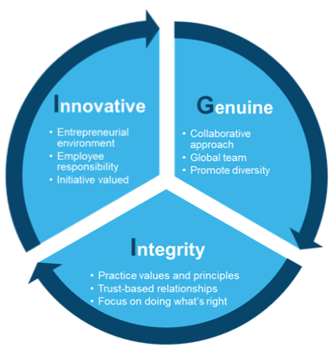
Commitment to Social Responsibility and Governance
Our purpose: To provide peace of mind in times of uncertainty.. This is core to our values, our business, and our corporate character.. We have a long track record of supporting our people and our communities.
IGI Values are Embedded Throughout the Company
Mature governance structure:
  Majority independent Board with well-defined committees and charters
  Robust corporate policies – subject to regular review
  ESG Committee established and meets quarterly reporting to Executive and Board
History of community and social support:
  Significant investment in support of arts, educational, and health initiatives
  Culture of participation and giving back to the communities where our people live and work
Long standing commitment to Diversity & Inclusion:
  Diversified workforce: culture, gender, religion, race, age, etc.
  Sixth consecutive year of support for Lloyds of London ‘Dive In Festival’ supporting D&I in insurance; designated country lead for future ‘Dive In’ events in Jordan
Sustainability:
  ESG Committee progressing sustainability and climate risk initiatives

Slide 16

Appendix

Slide 17
Selected Financial Data
 | IFRS (Audited) |  |  |  | U.S. GAAP (Unaudited) |  | U.S. GAAP (Unaudited)
 | Year Ended December 31, |  |  |  | Year Ended December 31, |  | Quarter ended September 30,
($ in mm) | 2017 | 2018 | 2019 | 2020 | 2021 | 2022 | 2022 | 2023
Operating Results:
Gross Written Premiums | $275.1 | $301.6 | $349.2 | $467.3 | $537.6 | $582.0 | $120.1 | $150.3
Underwriting Income | $23.6 | $56.1 | $52.0 | $77.4 | $104.0 | $148.6 | $42.0 | $49.7
Core Operating Income | $0.3 | $29.5 | $21.6 | $35.6 | $53.0 | $94.2 | $28.1 | $36.3
Core Operating Return on Equity ⁽¹⁾ | 0.1% | 9.8% | 7.0% | 10.3% | 14.3% | 23.8% | 29.7% | 31.0%
Key Metrics:
Loss Ratio | 59.2% | 46.5% | 54.8% | 53.5% | 51.0% | 41.9% | 38.2% | 37.3%
Net policy acquisition expense ratio | 24.7% | 22.9% | 21.1% | 19.2% | 18.3% | 18.6% | 18.3% | 17.1%
G&A expense ratio | 21.1% | 19.3% | 18.2% | 16.6% | 17.2% | 17.9% | 17.5% | 18.8%
Combined Ratio | 105.0% | 88.7% | 94.1% | 89.3% | 86.5% | 78.4% | 74.0% | 73.2%
Financial Position:
Investments and Cash Portfolio | $489.6 | $505.0 | $604.7 | $775.3 | $886.6 | $958.8 | $900.6 | $1,051.7
Debt | -- | -- | -- | -- | -- | -- | -- | --
Shareholders' Equity | $301.4 | $301.2 | $312.1 | $381.0 | $381.1 | $411.0 | $382.0 | $470.1
Book Value per Share | -- | -- | -- | $8.39 | $8.38 | $9.07 | $8.80 | $11.04
Select Ratios:
Retention Ratio (NPW / GPW) | 58.4% | 67.4% | 72.2% | 72.4% | 71.1% | 67.9% | 48.3% | 59.6%
Premium Leverage (NPE / Shareholders' Equity)⁽²⁾ | 48.7% | 60.8% | 71.6% | 90.8% | 94.7% | 98.8% | 101.2% | 105.9%
Debt-to-Total Capitalization Ratio | 0.0% | 0.0% | 0.0% | 0.0% | 0.0% | 0.0% | 0.0% | 0.0%
(1) Represents annualized core operating income for the period divided by average shareholders’ equity; Average shareholders’ equity equals the total equity at the reporting period end plus the total equity as of the beginning
of the reporting period, divided by 2.
(2) Represents annualized net premium earned for the quarter divided by prior year end shareholders’ equity.

Slide 18
Summary Income Statement
 | IFRS (Audited) |  |  |  | U.S. GAAP (Unaudited) |  |  | U.S. GAAP (Unaudited)
 | Year Ended December 31, |  |  |  | Year Ended December 31, |  |  | Quarter ended September 30,
($ in mm) | 2017 | 2018 | 2019 | 2020 | 2021 | 2022 | # | 2022 | 2023
Gross Written Premiums | $275.1 | $301.6 | $349.2 | $467.3 | $537.6 | $582.0 |  | $120.1 | $150.3
Ceded Written Premium | (114.3) | (98.2) | (97.1) | (128.9) | (155.2) | (187.0) |  | (62.1) | (60.7)
Net Written Premiums | $160.8 | $203.4 | $252.2 | $338.4 | $382.4 | $395.0 |  | $58.0 | $89.6
Net Change in Unearned Premiums | (14.0) | (20.1) | (36.6) | (54.9) | (43.2) | (18.6) |  | 38.4 | 19.3
Net Premiums Earned | $146.7 | $183.3 | $215.5 | $283.5 | $339.2 | $376.4 |  | $96.4 | $108.9
Net Loss and Loss Adjustment Expenses | (86.9) | (85.3) | (118.1) | (151.7) | (173.0) | (157.6) |  | (36.8) | (40.6)
Net Policy Acquisition Expenses | (36.2) | (42.0) | (45.4) | (54.4) | (62.2) | (70.2) |  | (17.6) | (18.6)
Underwriting Income | $23.6 | $56.1 | $52.0 | $77.4 | $104.0 | $148.6 |  | $42.0 | $49.7
Net Investment Income | 13.6 | 9.4 | 13.0 | 8.5 | 10.9 | 14.7 |  | 5.6 | 9.0
General & Administrative Expenses | (30.9) | (35.4) | (39.3) | (46.9) | (58.2) | (67.2) |  | (16.9) | (20.5)
Listing Associated Extraordinary Expenses | - | - | (4.8) | (3.4) | - | - |  | - | -
Other Expenses, net | (1.8) | (1.2) | (1.4) | (4.4) | (2.2) | (1.5) |  | (0.2) | (2.7)
Changes in Fair Value of Derivative Financial Liabilities | - | - | - | (4.4) | 0.7 | 4.6 |  | (0.1) | (17.2)
Change in allowance for credit losses on financial asets |  |  |  |  | (3.3) | (3.0) |  | (0.1) | 0.5
Gain / (Loss) on Foreign Exchange | 2.6 | (3.4) | 5.7 | 2.5 | (3.4) | (3.5) |  | (6.9) | (6.5)
Net Income Before Tax | $7.0 | $25.6 | $25.3 | $29.3 | $48.5 | $92.7 |  | $23.4 | $12.3
Tax Expense | 0.0 | (0.1) | (1.7) | (2.1) | (1.8) | (2.9) |  | (0.8) | (1.4)
Net Income | $7.0 | $25.5 | $23.6 | $27.2 | $46.7 | $89.8 |  | $22.6 | $10.9

Slide 19
Reconciliation – Core Operating Earnings
 | IFRS (Audited)
 | Year Ended December 31,
($ in mm) | 2017 | 2018 | 2019 | 2020
Net Income for the period | $7.0 | $25.5 | $23.6 | $27.2
Net Realized Losses / (Gains) on Investments (tax adjusted) | (3.1) | (1.3) | (1.0) | (0.9)
Net Impairment Losses Recognized in Earnings | 0.1 | 0.0 | (0.0) | -
Unrealized Loss (Gain) on Revaluation on Financial Assets⁽¹⁾ | - | 0.9 | (1.6) | -
Change in Allowance for Credit Losses on Investments | - | - | - | 0.3
Unrealized Losses / (Gains) on Investments (tax adjusted)⁽¹⁾ | (0.1) | - | - | -
Fair Value Losses / (Gains) on investment properties | - | - | 0.3 | 2.0
Fair value (Gain) / Loss on investment properties held through associates | (1.0) | 0.9 | 0.4 | 1.5
Changes in Fair Value of Derivative Financial Liabilities | - | - | - | 4.4
Net Foreign Exchange (Gain) / Loss (Tax Adjusted)⁽¹⁾ | (2.6) | 3.4 | (4.9) | (2.3)
Listing Associated Extraordinary Expenses⁽²⁾ | - | - | 4.8 | 3.4
Core Operating Income | $0.3 | $29.5 | $21.6 | $35.6
 | U.S. GAAP (Unaudited) |  | U.S. GAAP (Unaudited) |  | U.S. GAAP (Unaudited)
 | Year Ended December 31, |  | Quarter Ended Septemer 30, |  | Nine Months Ended September 30,
 | 2021 | 2022 | 2022 | 2023 | 2022 | 2023
Net Income For the Period | $46.7 | $89.8 | $22.6 | $10.9 | $66.8 | $85.2
Net realized (gain) loss on investments (tax adjusted) ⁽¹⁾ | (0.3) | 0.7 | 0.6 | (4.7) | 0.6 | (4.7)
Net unrealized (gain) loss on investments (tax adjusted) ⁽¹⁾ | 3.8 | 5.3 | (0.1) | 5.8 | 7.0 | (2.1)
Change in allowance for credit losses on investments (tax adjusted)⁽¹⁾ | 0.2 | 0.1 | (0.7) | 0.1 | -- | (0.2)
Change in fair value of derivative financial liabilities | (0.7) | (4.6) | 0.1 | 17.2 | (5.2) | 20.5
Expenses related to conversion of warrants in cash ⁽³⁾ | -- | -- | -- | 2.0 | -- | 2.0
Net foreign exchange loss (gain) (tax adjusted) ⁽¹⁾ | 3.3 | 2.9 | 5.6 | 5.0 | 11.2 | 3.0
Core Operating Income | $53.0 | $94.2 | $28.1 | $36.3 | $80.4 | $103.7
(1) Represents a non-GAAP financial measure as the line item balances reported in the “Summary Income Statement” have been adjusted for the related tax impact.
(2) Related to the business combination with Tiberius Acquisition Corp. in March 2020.
(3) This expense is included in ‘Other expenses’ line item in the condensed consolidated statements of income.

Slide 20
For more information:
Investor Relations
Robin Sidders (Head of Investor Relations)
Email: Robin.Sidders@iginsure.com
Mobile: +44 7384 514785

